Slide 1

seL4 Overview and Tutorial
Unclassified
Nicholas Evancich
nick@trustedst.com
Trusted Science and Technology, Inc.

Slide 2

Agenda
OVERVIEW OF seL4
History
Capabilities
Threads
Booting
TUTORIAL
Code walk through
seL4Test
Hello SecDev
Threads
Capabilities

Slide 3
What is seL4
seL4 = Secure Embedded L4 Microkernel
seL4 is the world’s first microkernel that brings with it a formal proof of correctness
The kernel was designed against a specification and the translation of the source code to binary representation hold correctness proofs with them as well
What does seL4 prove?
The binary code of the ARM version of the seL4 microkernel correctly implements the behavior described in its abstract specification and nothing more. Furthermore, the specification and the seL4 binary satisfy the classic security properties called integrity and confidentiality. (https://sel4.systems/Info/FAQ/proof.pml)
Integrity and Confidentiality derive from the CIA definition
Confidentiality refers to a system’s efforts to keep their data private
Integrity ensures that data has not been tampered with and, therefore, can be trusted

Slide 4
What is a microkernel
Have been around since the early 70’s
Being formally recognized/coined in 1981 (Accent from Carnegie-Mellon)
Near minimum amount of software that can provide mechanisms needed for an operating system.
Some mechanisms (Bare-minimum)
Low level address space management
Thread Management
Inter Process Communication
Interrupt management/routing
Generally the kernel is the most privileged, everything else contained in user space

Slide 5
Microkernel (Pros & Cons)
ADVANTAGES
Modularity
Servers can be plugged, swapped, and restarted easily
Security
Separation of address spaces managed by the kernel
Robustness
The limited requirements of a microkernel generally lead to a simpler code base
This is easier to test/peer review
Driver cannot directly crash the kernel
A system can be resurrected by monitor servers
DISADVANTAGES
Performance
More context switches
Because of crossing from User space to kernel space
A user space driver now communicates via IPC messages to another user space process
In a monolithic kernel a driver would be in kernel space and already be at a high privilege
Complex process management
Generally not as many application/services for developers to build on
Usually need to implement your own key components

Slide 6
Microkernel (cont)
Common Characteristics
User space drivers and applications
IPC communication
Small kernel because of small set of responsibilities
Other Microkernels
L4 Family (seL4, OKL4, Fiasco.OC)
GNU Hurd
MINIX (Andrew Tanenbaum’s academic microkernel)
Magenta (Google’s microkernel for Fuchsia OS)
Redox (A Rust microkernel)
QNX (Blackberry’s microkernel)

Slide 7
seL4 History
In the L4 Family of Microkernels
Stems from Jochen Liedtke 1993 i386 assembly version
Has been generalized because the different L4’s don’t necessarily use the original ABI
L4 Kernels have a branching history of implementations
The UNSW (Univ New South Wales) group at NICTA’s L4-embedded version was the first to focus on embedded systems favoring
smaller memory footprints
lower complexity
OKLabs spun out from UNSW/NICTA with a commercial offering of L4, OKL4 (2006-2008)
This had capability based security

Slide 8
seL4 History (cont)
Share basic mechanism concepts
Address Spaces
Threads
Scheduling
Thin IPC implementation between isolated servers
seL4 was originally created at OKLabs from scratch and implemented in a Haskell specification
Resource access is determined by a capability model which enables formal reasoning about an object’s permissions
Formal proof of functional correctness was completed in 2009
Proves implementation is correct against the Haskell specification
Proves the kernel is free of deadlocks, livelocks, buffer overflows, arithmetic exceptions or use of uninitialized variables
Formal proof of C to binary translation

Slide 9
What does seL4 prove?
Kernel Specification
Kernel’s C-code
Binary Representation

Slide 10
What properties does this imply?
This implies that the seL4 kernel lacks the following:
Buffer overflows
Null point dereferences
Memory leaks
Arithmetic overflows and exceptions
Undefined behavior
General pointer errors
Assuming the assumptions are correct
Source: https://sel4.systems/Info/FAQ/proof.pml

Slide 11
Assumptions
Assembly
Small amount of asm written and is assumes to be good
Hardware
HW is working within its spec
HW Management
Cache, TLB, etc are implemented correctly
Boot code
Boot code puts the kernel into a good state
DMA
Only the CPU & MMU can directly access memory
Info side-channels
Does not cover timing channels

Slide 12
Capability Security Model
Capability Security Model (CSM) is a design pattern in trustworthy computing
A capability is a key
It provides authority that references an object and provides certain access rights
seL4 provide an implementation of this model with unique features

Slide 13
seL4 & CSM
Capability spaces are implemented as a directed graph of kernel-managed capability nodes (CNodes)
The reason why capabilities form the basis of security in seL4 is the fact that the kernel keeps track of everything in the capability derivation tree and a capability is required for any operation on a kernel object
This prevents bad actor threads from gaining access to a resource in a trusted thread that they aren’t supposed to have access to
Capabilities are unforgeable, transferable, and extensible
If a thread is monitored and malicious behavior is detected, the capabilities that thread has can be revoked by a thread that owns a capability further up the capability derivation tree

Slide 14
Cspaces & CNodes
In seL4, there are a few related structures to be familiar with when talking about capabilities:
Cspace
Directed graph of Cnodes
All capabilities reachable from the root of the Cspace
Capability Pointer (CPTR)
The address or pointer to a capability
CSpace Path (seL4_libs/libsel4vka/include/vka/cspacepath_t.h)
A structure for describing the capability in the graph
Croot
The beginning of a Cspace
CSpace Node (CNode)
Table of slots
Each slot may contain a capability

Slide 15
VSpaces
Virtual address spaces are chunks of kernel managed memory that threads can use to run in, while being isolated from the rest of the system
A thread must poses a capability to a chunk of untyped memory, which it can retype as virtual memory
This virtual memory can be associated with a thread object and when the thread is started, it will execute inside of that memory

Slide 16
VSpaces (cont)
The memory objects are hardware dependent. For ARM, some important objects are:
Page Directory (PD)
Page Directory Entry (PDE)
Entry in the page directory
Contains a pointer to a page table, page, or it can be invalid
Page Global Directory (PGD)
Page Upper Directory (PUD)
Page Table (PT)
Contains page table entries
Page Table Entry (PTE)
An entry in a page table
Contains a pointer to a page or it can be invalid
Page
Actual physical memory, usually a 4k region
This can be mapped into a VSpace.

Slide 17
Untyped Memory
Untyped memory is the default classification of memory in seL4
Untyped memory is required to re-type into another kernel object
This means that the thread that invokes the untyped memory needs to have access to that to change it to something else
When untyped memory is retyped, the kernel knows about it and can keep track of how it is used

Slide 18
Kernel Overview
The seL4 kernel isolates applications and provides primitive mechanisms for these isolated instances to communicate with one another
It is up to the userspace libraries to abstract these primitives and provide easier to use API’s
The kernel provides objects for threads, address spaces, inter-process communication, notifications, device primitives, and capability spaces
These objects can be used in user space to interact with the kernel and other objects
These services are invoked with system calls, which consist of the kernel object to be operated on and the capability to that object, some of which can take more arguments

Slide 19
Root Thread
The most important chunk of data to worry about once the root thread’s main function starts to execute is the bootinfo structure. This is what other objects are built from.
Some important information that the bootinfo struct contains is the root thread’s TCB object, the initial CSpace, VSpace, and IPC buffer.
The bootinfo struct can be found in kernel/libsel4/include/sel4/bootinfo_types.h
To acquire the original boot information, the platsupport_get_bootinfo function will initialize a user space boot info variable
From here, memory can be allocated, capabilities minted and passed, and a whole slew of other exciting seL4 activities.

Slide 20
Thread Control Blocks
seL4 uses threads to group executing contexts together
Threads are contained by Thread Control Block tcb_tstructures
As of version 8.0 of the seL4 code base, these can be seen in kernel/include/object/structures.h
Each TCB has an associated CSpace and Vspace
Like other objects, TCBs are created with the seL4_Untyped_Retype() method
A newly created thread is initially inactive
It is configured by setting
its CSpace and VSpace with the seL4_TCB_SetSpace() or seL4_TCB_Configure() methods and then calling seL4_TCB_WriteRegisters() with an initial stack pointer
and instruction pointer
The thread can then be activated either by setting the resume_target parameter in the seL4_TCB_WriteRegisters()

Slide 21
Endpoints
Allow small amounts of data and capabilities to be transferred between two threads
Invoked with seL4 system calls:
seL4_Send
seL4_Call
seL4_Recv
seL4_ReplyRecv

Slide 22
IPC
IPC is the mechanism for thread-to-thread and thread-to-kernel communication
IPC messages can be sent to either an “Endpoint” or other kernel objects
The seL4 IPC model consists of the thread having the capability to access the kernel object of interest and then loading up the thread’s message register
IPC message registers have 3 descriptive registers that are backed by CPU registers and anywhere from 1-4 “Message Registers” that are backed by the thread’s IPC buffer (& thread_t.tcbIPCBuffer)

Slide 23
IPC (cont)
Capability Register
Badge Register
Message tag (seL4_MessageInfo_t)
Has four fields
Label
Kernel does not do anything with this
First data payload of the message
Message Length
Number of capabilities
Capabilities Unwrapped
Used only on the receive side
Indicates the manner in which capabilities were received
Message Registers

Slide 24
Notification
Notifications are the non-blocking signaling mechanism that applications running on seL4 can use as binary semaphores
Related sel4 system calls:
seL4_Signal
Updates the notification object’s word
Unblocks the first thread waiting on the notification, while all other threads that are waiting on the notification object keep waiting until the next time the notification is signaled.
If invoked with an un-badged capability the first queued thread is unblocked
seL4_Wait
If notification object’s word is zero the invoker blocks
If notification object’s word is not zero then the call returns and sets the notification object’s word to zero
seL4_Poll
If notification object’s word is zero the call will return immediately without blocking
If notification object’s word is not zero then the call returns and sets the notification object’s word to zero
seL4_TCB_BindNotification
Binds notification objects and TCBs together

Slide 25
Kernel Boot Sequence
After the board is set up with the bootloader and execution is handed off to the elfloader, where it then branches to the kernel
The kernel boot sequence can be traced in src/arch/arm/kernel/boot.c
The first function to be called is init_kernel
Then try_init_kernel is called and depending on the number of CPUs, this function branches to try_init_kernel_secondary_core

Slide 26
Kernel Boot Sequence (cont)
In try_init_kernel several important things happen:
Virtual memory for the kernel is set up in map_kernel_window.
This also calls map_kernel_devices
Where the platform dependent kernel_devices gets mapped
This is 32/64 bit dependent and in the src/arch/arm/$ARCH/machine/hardware.c source file.
CPU is initialized in init_cpu
The activate_global_pd is a macro that is dependent on whether it is running in 32 or 64 bit mode
In 64 bit mode this actually calls activate_kernel_vspace
This function is in src/arch/arm/64/kernel/vspace.c
The kernel stack is set up
The timer is initialized

Slide 27
Kernel Boot Sequence (cont)
Platform is initialized in init_plat
The IRQ Controller is initialized with initIRQController
The implementation of this is found in src/plat/$PLAT/machine/ or src/arch/arm/machine/gic_$GIC_VERSION.c
The L2 Cache is initialized
In the future other platform dependent initializations may take place here
Capabilities are created for the root environment
The boot info frame is allocated and initialized
The initial address space is created
The boot info frame capability is created
The initial threads IPC buffer is created
This is all brought together and the initial thread control block of type tcb_t is created with a call to create_initial_thread
L1 cache is invalidated
Execution is returned to the init_kernel function

Slide 28
Navigating the Code Base
The directory structure of the seL4 kernel, libraries, and tools are organized based on a repo manifest file, which pulls the correct git repositories and places them in a certain place
The repo tool places everything such that the root directory is not tracked by git but the sub directories are still tracked by their respective repositories
This makes it relatively easy for build tool files to reference other projects and not muddy up the source trees with generated and compiled code

Slide 29
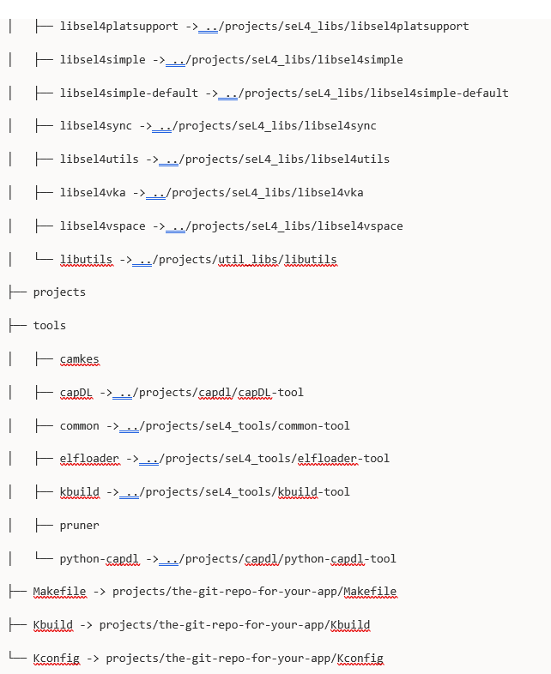
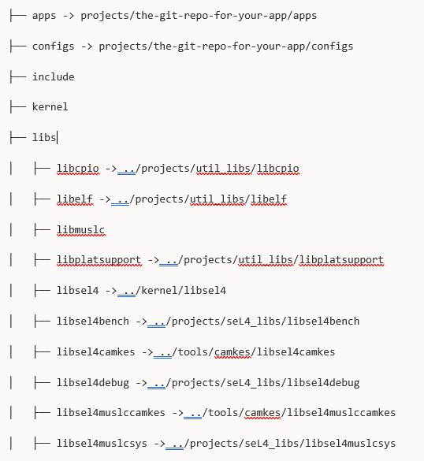
Navigating the Code Base (cont)

Slide 30
Navigating the Code Base (cont)
At first glance the directory structure can be somewhat intimidating
If you are ever confused where certain components might be, the main directories where source code is located are kernel and projects
The kernel directory is, obviously enough, where all the kernel code is. However, as can be seen in the previous listing, the apps directory is really a link to a directory under projects and so are some library directories under libs and some tools directories under tools
You can see where all of the directories are placed and linked to in the project manifest file
You can run the command repo manifest at the command line and it will print the contents of the currently used manifest file in .repo/manifest.xml
Each entry has a path, which is where the directory for that git repository is placed

